Slide 1
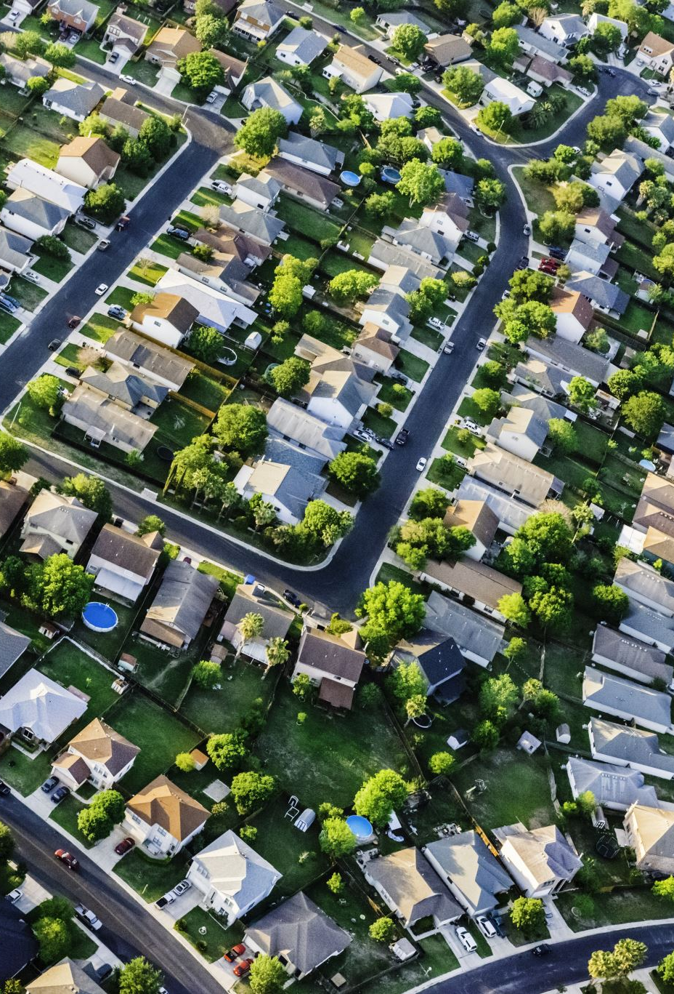
Housing Affordability in Metro Nashville During a Period of Market Disruption (2020–2023)
Luke Gaffney | DDA17 Capstone Project

Slide 2
Purpose of this Analysis
Examine changes in housing affordability in Metro Nashville from 2020–2023
Evaluate the roles of home prices, income, housing supply, and mortgage rates
Identify whether affordability impacts differed across ZIP codes

Slide 3
Research Questions
How did median home values in the Metro Nashville area change between 2020 and 2023, and did household income growth keep pace with these increases?
How did housing supply indicators including vacancy rates, occupied units, and housing stock change between 2020 and 2023, and what relationship did these trends have with housing affordability in Metro Nashville?
How did changes in 30-year fixed mortgage interest rates between 2020 and 2023 affect homeownership affordability in Metro Nashville, and how did the share of households able to afford a median-priced home change during this period?
Were changes in housing affordability evenly distributed across Metro Nashville between 2020 and 2023, or did certain ZIP codes experience more rapid declines in affordability than others?

Slide 4
About the data
Dataset | Source | Geography | Used For
Residential Property Sales | Metro Nashville (data.nashville.gov) | Individual parcels | Sale prices, zoning, spatial patterns
Housing Market Trends | Redfin | Nashville Metro Area | Market prices, supply & demand
Income & Housing Costs | U.S. Census (ACS) | ZIP codes (ZCTA) | Income, home values, rent
Population & Poverty | U.S. Census (ACS) | ZIP codes (ZCTA) | Population, vacancy, poverty
Mortgage Rates | Federal Reserve (FRED) | National | Financing conditions
ACS data are 5-year estimates. ZCTAs approximate postal ZIP codes. Missing values were excluded.

Slide 5
Nashville Housing Market Metrix's
40,434
Total Homes Sold
10,109
Average Yearly Home Sales
$320,000
Median Sale Price 2020
$437,200
Median Sale Price 2023
981,955
Average Population
$82,883.40
Median Household Income
$1,413.51
Median Rent Price
4.55%
Average Mortgage Rate

Slide 6
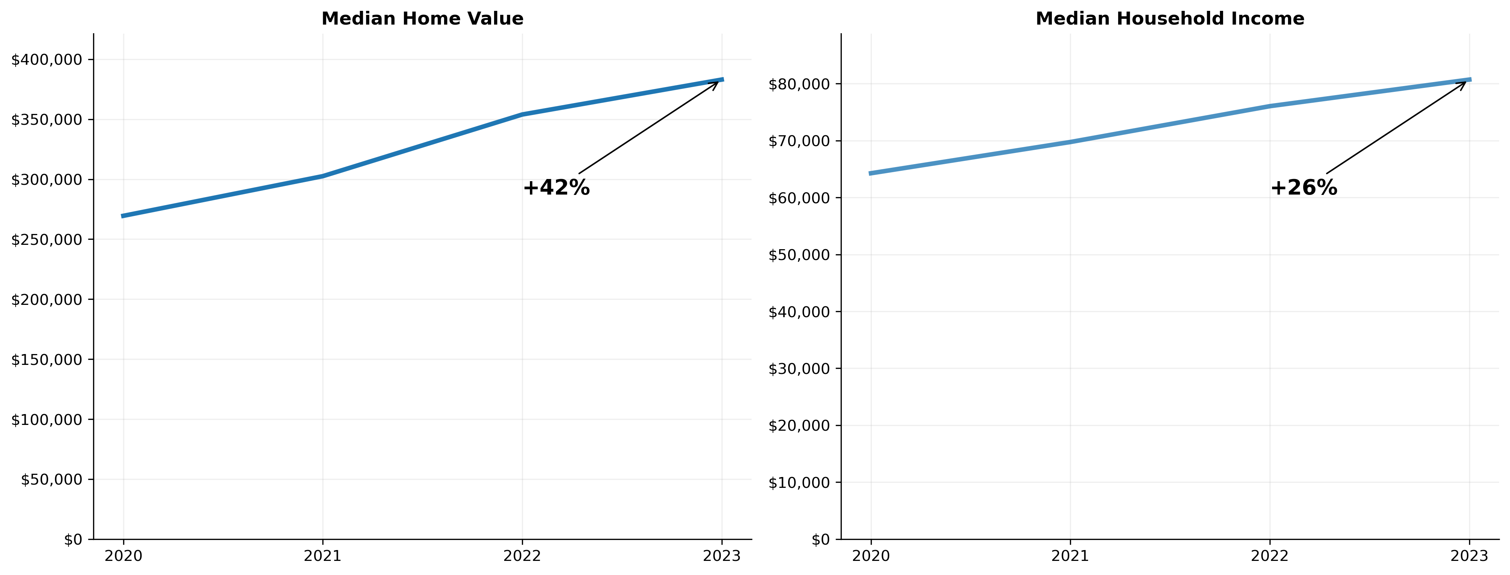
Home Prices vs Income in Metro Nashville (2020–2023)
Home prices increased substantially faster than household income
Between 2020 and 2023, median home values increased by over 40%, while median household income grew by approximately 25%.

Slide 7
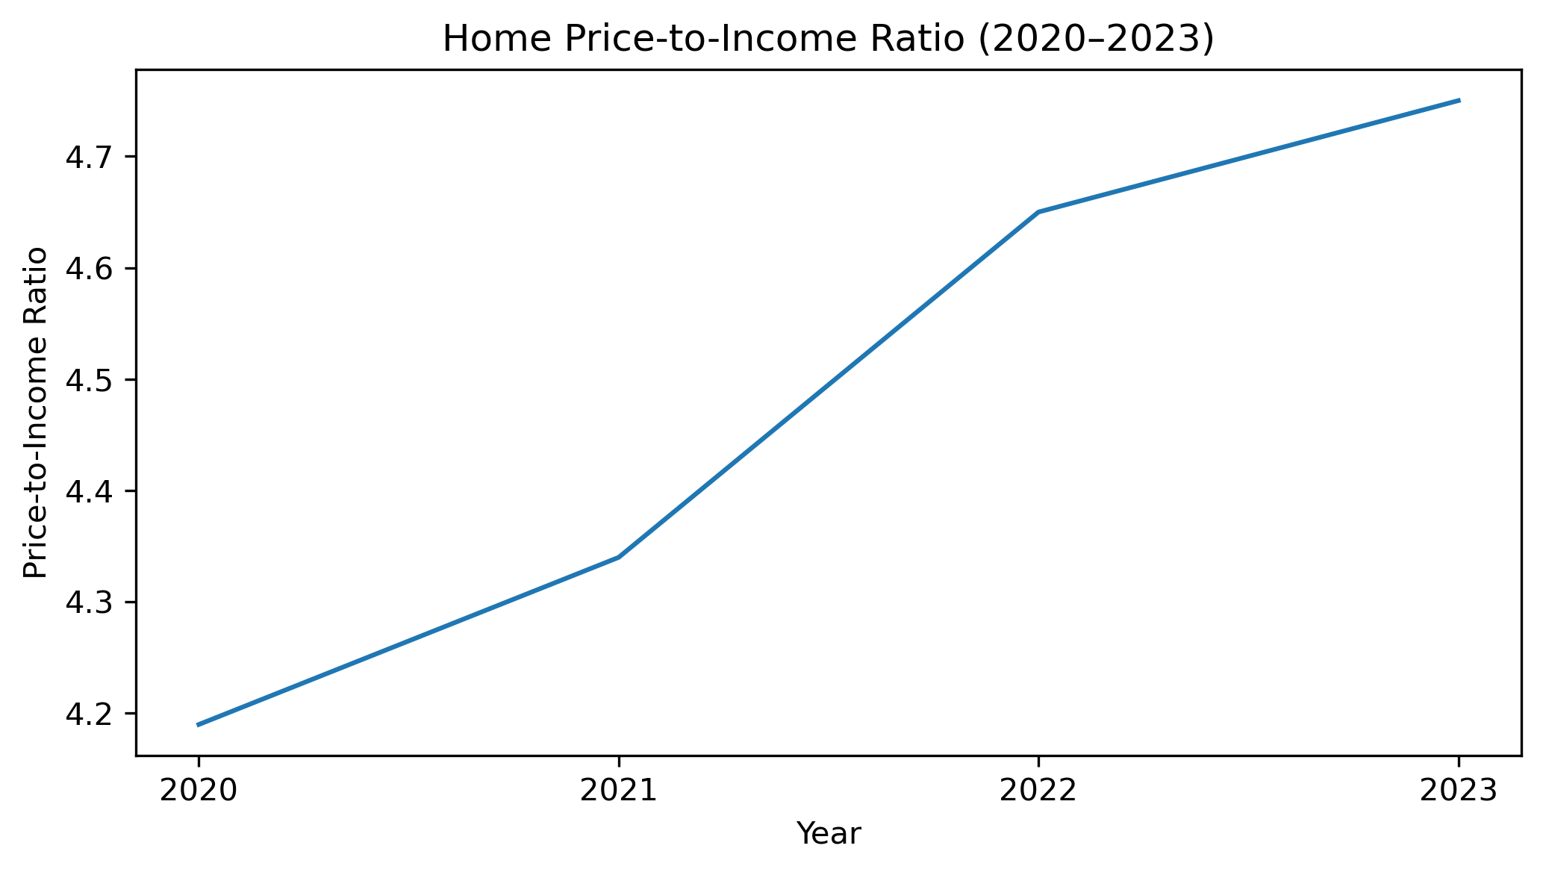
The Price-to-Income Gap Has Widened in Metro Nashville (2020–2023)
Rising home prices outpaced income growth, worsening housing affordability
The rising price-to-income ratio indicates that housing became less affordable for median-income households between 2020 and 2023.

Slide 8
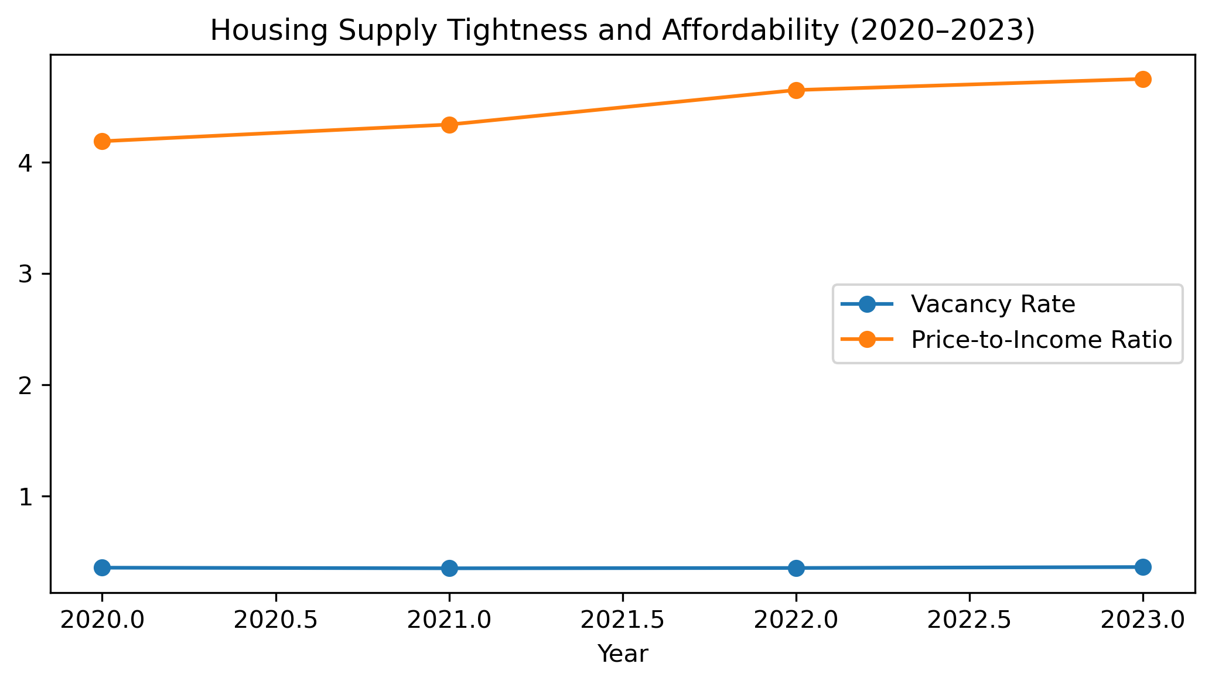
Housing Supply Trends
Between 2020 and 2023, total housing units in Metro Nashville increased modestly, while occupied units grew more rapidly, resulting in persistently low vacancy rates. This tightening of housing supply coincided with a steady increase in the price-to-income ratio, indicating declining housing affordability. These trends suggest that limited housing supply growth relative to demand contributed to rising home prices that outpaced income growth.

Slide 9
Mortgage Rates & Affordability

Slide 10
ZIP Code Affordability Differences

Slide 11
Key Findings

Slide 12
Limitations & Next Steps

Slide 13
Conclusion

